Slide 1
TEACHING LEARNING MATERIAL · DEEP LEARNING
Session 6
Transformers
From positional encoding and scaled dot-product attention, through the
encoder–decoder stack, to hand calculations and the Portuguese–English case study.
Attention
Self-attention
Multi-head
Positional encoding
Q, K, V
Source: Deep Learning TLM session 6.docx · Chapter 6 · Vaswani et al., 2017
Notes:
Open by contrasting Session 5 RNNs with the 2017 transformer: attention replaces recurrence.

Slide 2
SESSION MAP
What we will cover
01
Why Transformers
NLP tasks, the 2017 paper, and what RNNs could not encode
02
Architecture, deeply
Encoder, decoder, residual highway, positional encoding, FFN
03
Attention by hand
Q, K, V, scaled dots, softmax, multi-head, causal mask
04
Training & families
Pretrain / fine-tune, BERT–GPT–T5, sparse and long-context variants
05
Implementation
Portuguese → English translation: tokenize, mask, train, decode
TLM Deep Learning · Session 6 · Transformers
02
Notes:
Five blocks matching Chapter 6 of the TLM notes, plus worked numerical examples.

Slide 3
MOTIVATION
Transformers became almost universal
The notes list the tasks that the architecture now dominates — far beyond translation.
Machine translation
Summarization
Text generation
Seq2seq with no recurrent bottleneck.
Long source, shorter target — encoder–decoder.
Decoder-only LMs: GPT family.
Named entity recognition
Question answering
Classification / sentiment
Token-level labels from bidirectional context.
Read a passage, attend to the span.
Pool the encoder, then a small head.
Similarity & paraphrasing
Language modelling
Speech, vision, proteins
Shared encoder, compare embeddings.
Next-token and next-sentence objectives.
Any data that can be a sequence of tokens.
TLM Deep Learning · Session 6 · Transformers
03
Notes:
Notes p.1: also query understanding, offensive-message detection, reading comprehension. AlphaStar used attention in RL.

Slide 4
THE 2017 MOMENT
“Attention Is All You Need”
Google Research, Vaswani et al. — the paper that reset thirty years of NLP records.
What it replaced
What it introduced
• Recurrent layers as the default sequence model.
• Left-to-right (or bidirectional) hidden-state chains.
• The sequential bottleneck: step t cannot start before t−1 finishes.
• Pairwise word correlations that LSTMs could not reliably encode over long distances.
• Self-attention in place of recurrence.
• Positional encoding so order is not lost.
• Multi-head attention: many definitions of “relevant”.
• A stack of identical blocks with residual + LayerNorm.
• Full parallelism over the sequence on GPU / TPU.
TLM Deep Learning · Session 6 · Transformers
04
Notes:
Stress: the original transformer is still an encoder–decoder. Recurrence is gone; attention is the mixer.

Slide 5
FOUR KEY IDEAS
The transformer recipe
01
Positional encoding
Each token is paired with a number (or a sinusoid) that marks its place. The model can then learn that order matters.
02
Attention
A learned heatmap of how every target word looks at every source word — including off-diagonal alignments such as européenne → European + Economic.
03
Self-attention
The same mechanism inside one sentence. “server” in a restaurant is not “server” after crashed.
04
Multi-head attention
Several sets of W_Q, W_K, W_V run in parallel. Each head is a different definition of relevance, computed at once on accelerators.
TLM Deep Learning · Session 6 · Transformers
05

Slide 6
THE PROBLEM THEY SOLVED
Pairwise correlations over long range
What an LSTM actually does
What self-attention does instead
• Compresses the past into a single hidden / cell state.
• Information from token 1 must survive every gate until token n.
• That is a sequential information bottleneck.
• Attention (Bahdanau 2014) already helped — but still sat on top of an RNN.
• The notes: LSTMs could not encode pairwise correlations across a sentence.
• Every token may look at every other token in one step.
• Path length between any pair is O(1), not O(n).
• The mixer is a matrix multiply: QKᵀ, then a weighted sum of V.
• No recurrence → the whole sequence is encoded in parallel.
• Cost: O(n² · d). Fine for sentences; painful for books — hence later sparse variants.
TLM Deep Learning · Session 6 · Transformers
06
Notes:
This is the conceptual hinge of the session. Draw path-length O(n) vs O(1) on the board if needed.

Slide 7
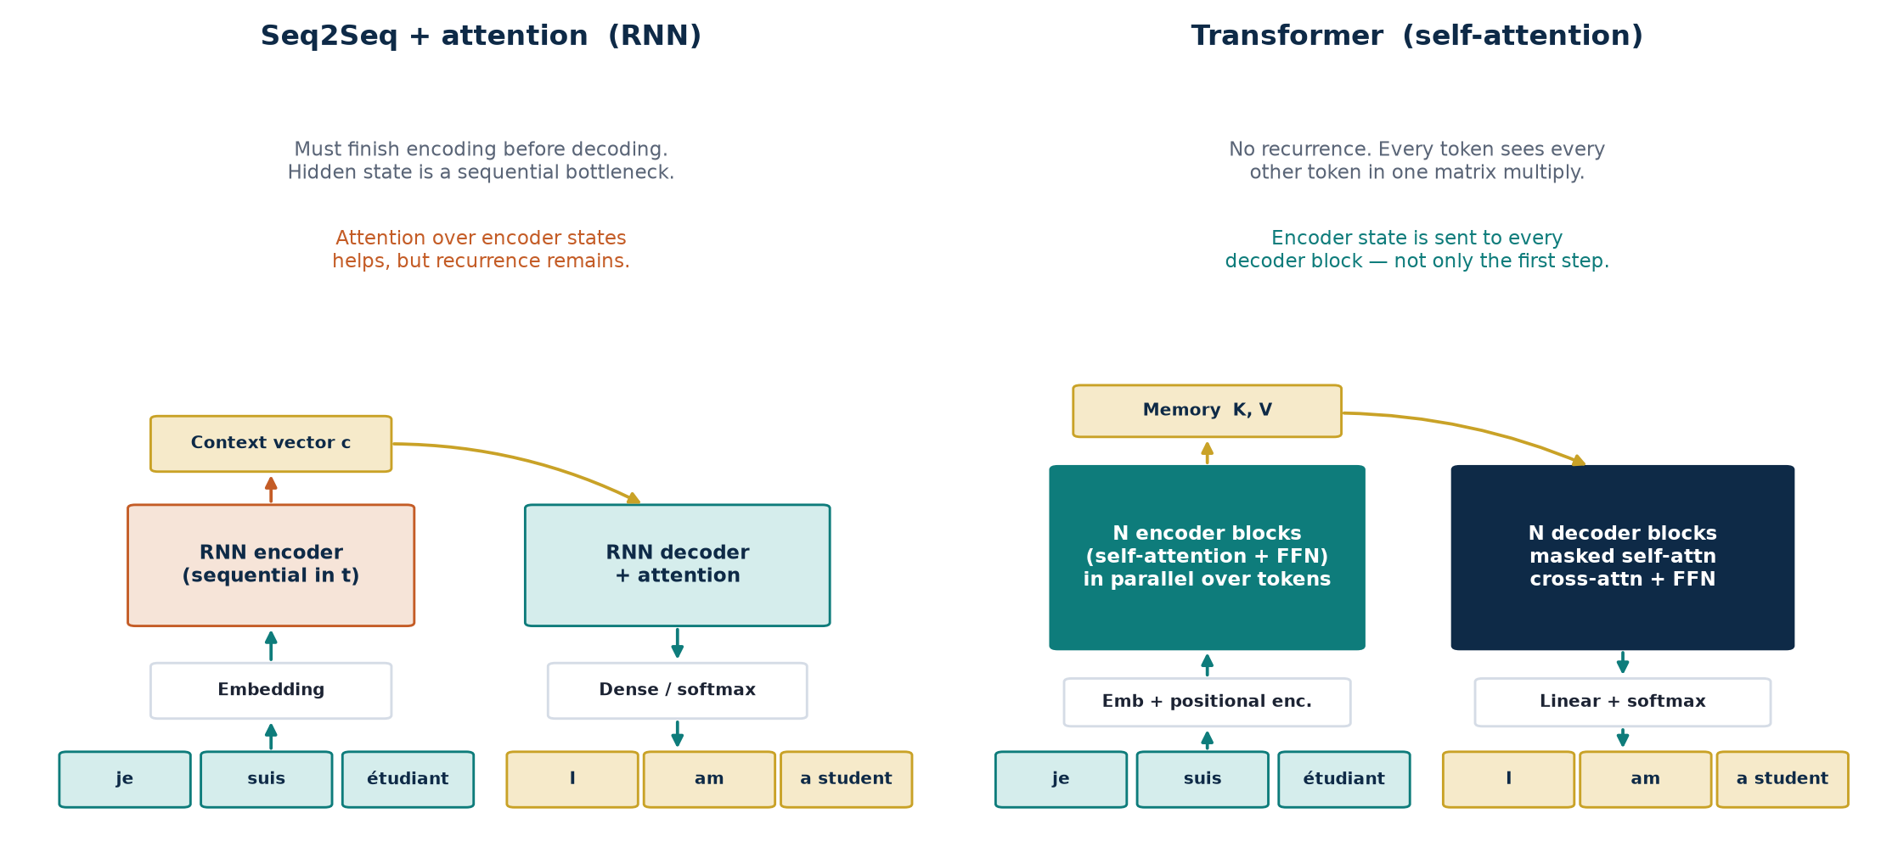
FIGURE 6.2 · NOTES
Seq2Seq + attention versus the Transformer
TLM Deep Learning · Session 6 · Transformers
07
Notes:
Same: source/target sequences, encoder–decoder, last encoder state used as context, dense+softmax. Different: recurrence gone; encoder state goes to EVERY decoder block; PE needed because of parallelism.

Slide 8
READING FIGURE 6.2
What is shared, and what actually changed
Same as seq2seq + attention
Where the Transformer diverges
• Works with a source sequence and a target sequence.
• Encoder–decoder skeleton.
• The last encoder block is a context / “thought” representation.
• Target embeddings go through a dense layer to integer / vocab IDs.
• RNN layers are replaced by transformer blocks.
• Encoder: multi-head self-attention + position-wise FFN.
• Decoder: masked self-attention + cross-attention + FFN.
• Encoder memory is sent to every decoder block, not only the first step.
• Because time is now parallel, positional encoding is required.
TLM Deep Learning · Session 6 · Transformers
08

Slide 9
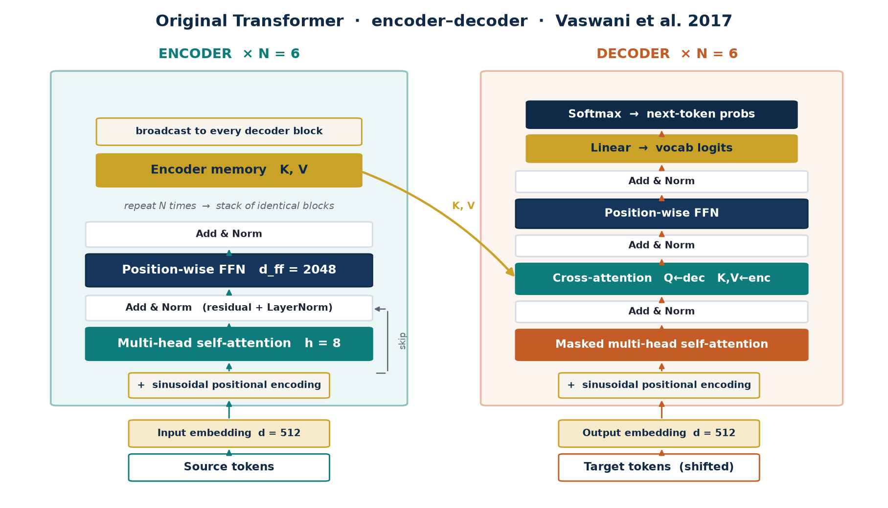
DEEP ARCHITECTURE
The original encoder–decoder, unpacked
TLM Deep Learning · Session 6 · Transformers
09
Notes:
Reference numbers from the paper / notes: N=6, h=8, d_model=512, d_k=d_v=64, d_ff=2048. Decoder has THREE sublayers per block.

Slide 10
ENCODER, DEEPLY
A bidirectional mixer — no future to hide
What goes in
What each block does
What comes out
Token IDs → embedding (512) + sinusoidal PE. The entire source is consumed at once. There is no left-to-right hidden-state walk.
Self-attention lets every source token re-read every other source token. The FFN then applies the same MLP to each position independently.
A sequence of contextual embeddings — the encoder memory. It is projected to K and V and broadcast to every decoder block.
Insight
The encoder is permutation-equivariant without PE: shuffle the tokens, the outputs shuffle the same way. Position is not “known” — it is added. That is why the first encoder input is embedding + PE, not embedding alone.
TLM Deep Learning · Session 6 · Transformers
10

Slide 11
DECODER, DEEPLY
Three sublayers, two kinds of attention
1 Masked self-attention
The target prefix attends only to itself. Look-ahead masking sets future scores to −∞ so the model cannot cheat by reading the answer.
2 Cross-attention
Q comes from the decoder; K and V come from the encoder memory. This is how “étudiant” is read while the model writes “student”.
3 Position-wise FFN
The same two-layer MLP (d_model → 2048 → d_model, ReLU) runs on every position. It is the block’s “thinking”, after attention has routed information.
Generation is still autoregressive: one token at a time, feeding the previous output back. Encoding is parallel; decoding is a loop. The notes are explicit about this split.
TLM Deep Learning · Session 6 · Transformers
11

Slide 12
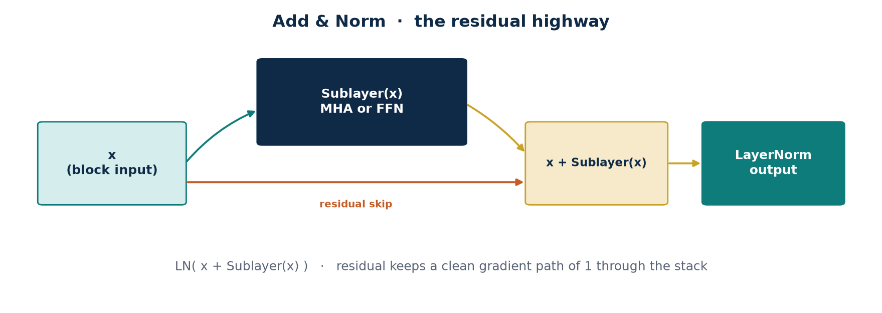
ADD & NORM
The residual highway is the real communication channel
Why residual?
Why LayerNorm?
Modern note
Each sublayer only writes a delta. The original signal — and a gradient of 1 — still flows. That is how we stack N = 6 blocks without the vanishing that killed deep RNNs.
Stabilises the scale of the residual stream so attention logits stay in a trainable range. Notes: residual + norm after both MHA and FFN.
The 2017 paper is post-norm: LN(x + Sublayer(x)). Many later LMs use pre-norm: x + Sublayer(LN(x)), which trains more stably at depth.
TLM Deep Learning · Session 6 · Transformers
12

Slide 13
POSITIONAL ENCODING
Order has to be injected — attention does not see it
Notes example: [(“Transformer”, 1), (“took”, 2), (“NLP”, 3), (“by”, 4), (“storm”, 5)]
Without position, self-attention is a bag of words. “The cat sat on the mat” would be indistinguishable from any permutation of the same tokens.
Absolute (original)
Relative
Rotary (RoPE)
A fixed sinusoid, no learned parameters, added to the embedding. Extrapolates to lengths not seen in training — in theory.
Encode distances i−j instead of absolute i. Better for “the word two seats to the left”.
Rotate Q and K by an angle that depends on position. Used in most modern LMs. The notes already flag this lineage.
TLM Deep Learning · Session 6 · Transformers
13

Slide 14
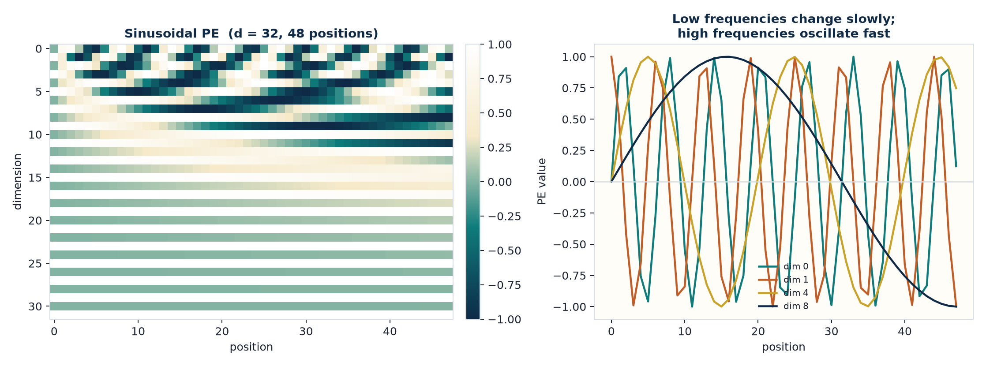
SINUSOIDAL PE
The formula from the original paper
No learned parameters · added, not concatenated
PE(pos, 2i) = sin( pos / 10000^{2i / d_model} )
PE(pos, 2i+1) = cos( pos / 10000^{2i / d_model} )
TLM Deep Learning · Session 6 · Transformers
14
Notes:
Low dimensions oscillate slowly (long-range), high dimensions oscillate fast (local). Even/odd channels are a sine/cosine pair so the model can learn relative shifts.

Slide 15
WORKED EXAMPLE · 1
Positional encoding by hand
Use d_model = 4 so every term is computable. Positions 0, 1, 2. Angles in radians.
Wavelengths, then the 4-D vector
i = 0 → 10000^{0} = 1 i = 1 → 10000^{2/4} = 100
PE(pos) = [ sin(pos/1) , cos(pos/1) , sin(pos/100) , cos(pos/100) ]
pos = 0
sin 0 = 0.000 cos 0 = 1.000 sin 0 = 0.000 cos 0 = 1.000
[ 0.000 , 1.000 , 0.000 , 1.000 ]
pos = 1
sin 1 = 0.841 cos 1 = 0.540 sin 0.01 = 0.010 cos 0.01 = 1.000
[ 0.841 , 0.540 , 0.010 , 1.000 ]
pos = 2
sin 2 = 0.909 cos 2 = −0.416 sin 0.02 = 0.020 cos 0.02 = 0.9998
[ 0.909 , −0.416 , 0.020 , 1.000 ]
TLM Deep Learning · Session 6 · Transformers
15
Notes:
Then x_pos = embedding + PE. In the paper this sum is the actual encoder input. Angles are in radians.

Slide 16
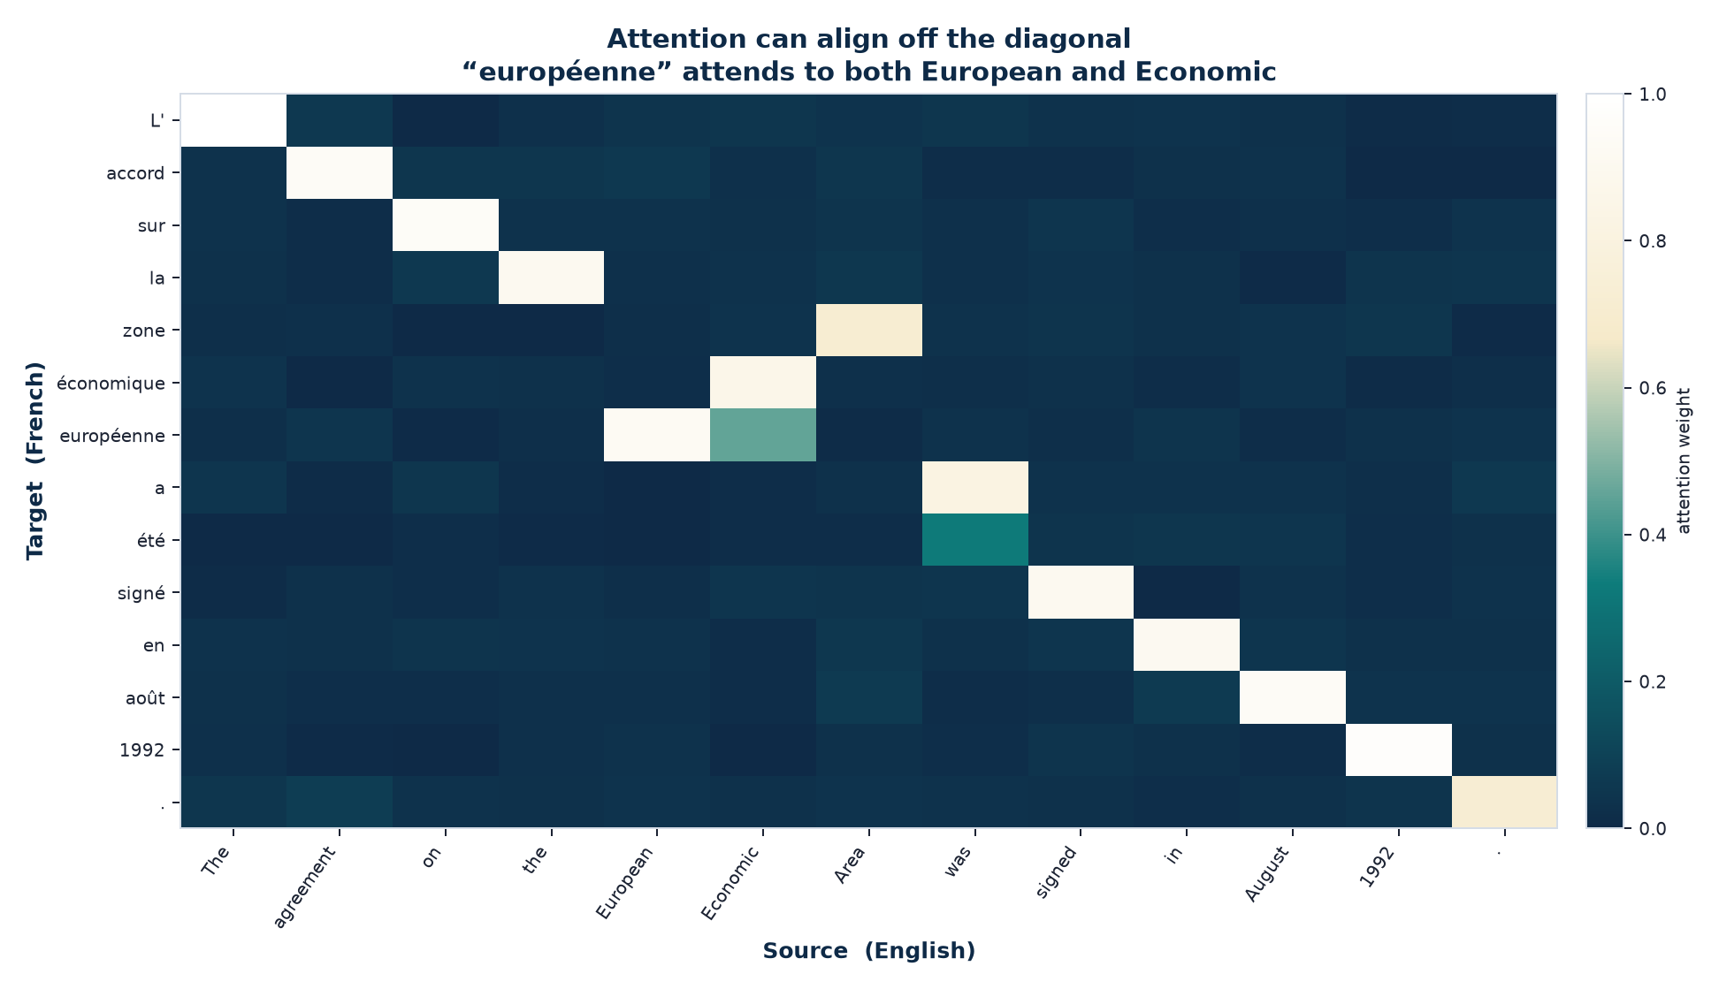
ATTENTION BEFORE TRANSFORMERS
Bahdanau alignment · notes Figure 6.1
“The agreement on the European Economic Area was signed in August 1992.”
What to see
• Most mass sits on the diagonal: word-to-word translation.
• européenne looks at both European and Economic — alignment is not 1-to-1.
• The network learned this heatmap with no alignment labels.
• This 2014 idea is the ancestor. The Transformer made attention the whole architecture.
TLM Deep Learning · Session 6 · Transformers
16

Slide 17
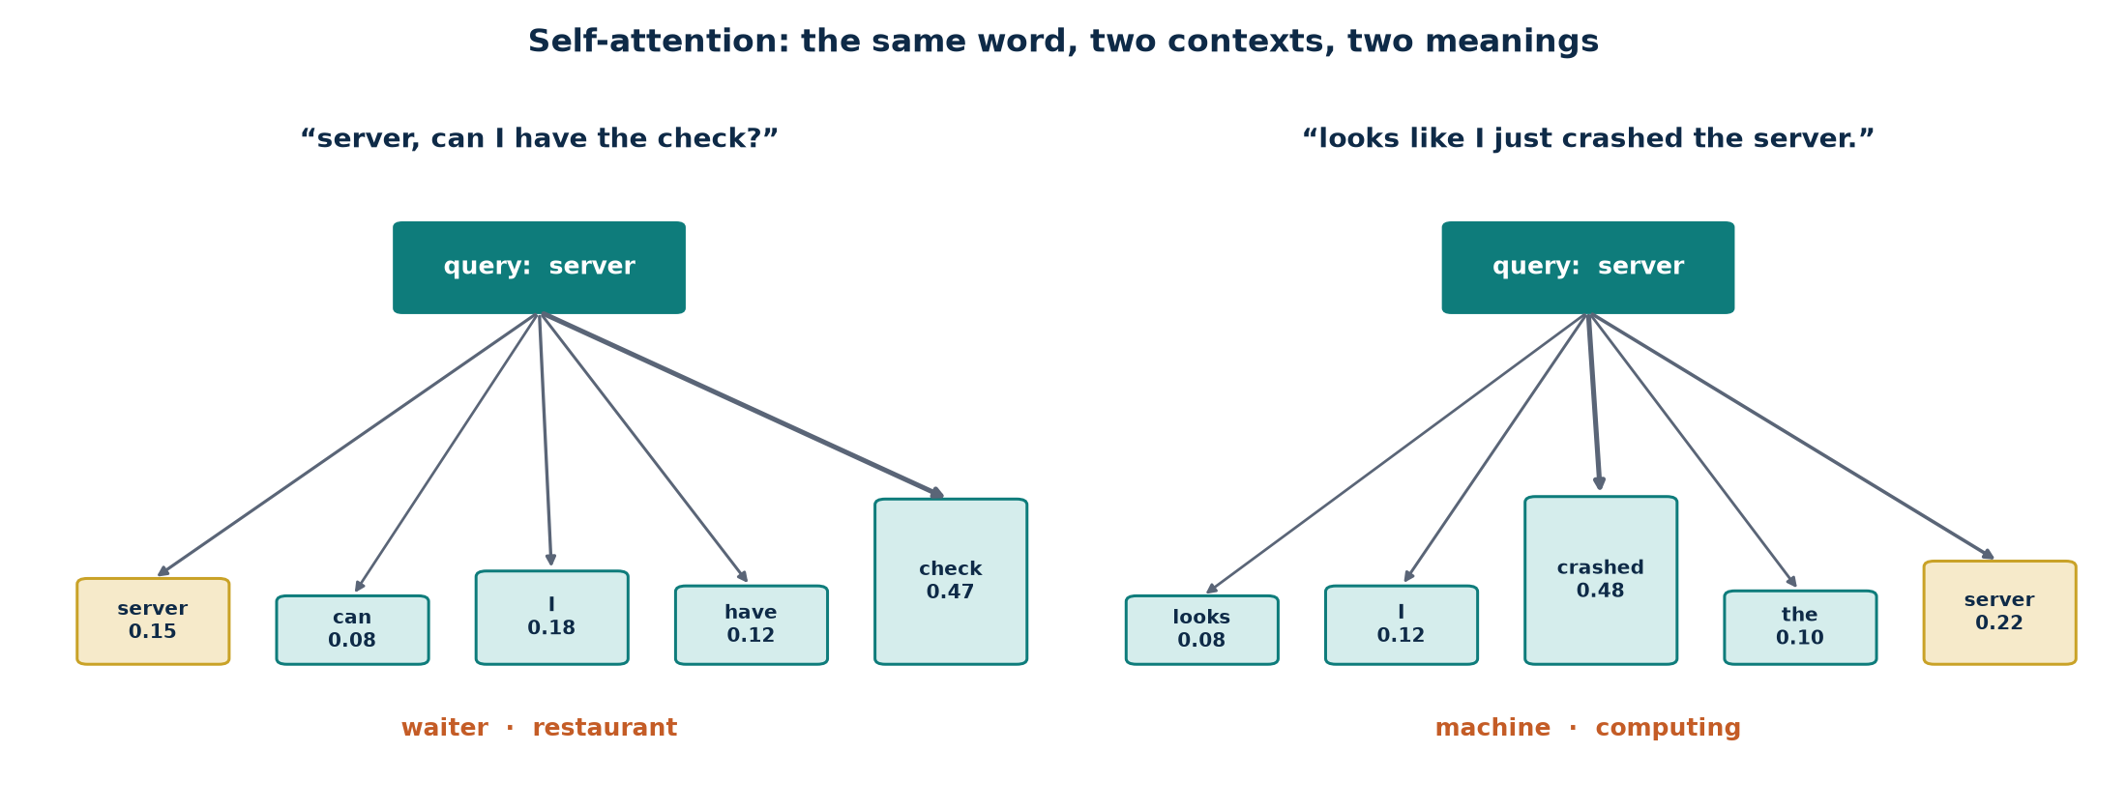
SELF-ATTENTION
The same word, two sentences, two meanings
Notes example. Attention can reach any token in the source; self-attention does that inside one sequence.
Self-attention (Cheng / LSTMN 2016, popularised in 2017) trains the network to learn relationships among all words in the input, irrespective of distance, before any translation happens.
TLM Deep Learning · Session 6 · Transformers
17

Slide 18
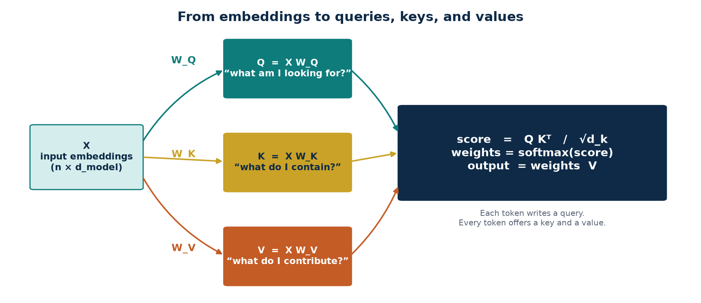
THE THREE ROLES
Query, key, and value are not three copies of the word
Query q_i = x_i W_Q
Key k_j = x_j W_K
Value v_j = x_j W_V
The word we are standing on. “What am I looking for in the rest of the sentence?”
Every word’s advertisement. “Here is the kind of content I hold.” The dot q·k is similarity.
The payload that actually gets mixed. High attention on j means more of v_j is written into i.
TLM Deep Learning · Session 6 · Transformers
18
Notes:
Attention from i to j is not equal to attention from j to i. The notes emphasise this asymmetry.

Slide 19
LEARNED PARAMETERS
Three matrices per head, plus W_O
W_Q
d_model × d_k
Projects the residual stream into query space.
W_K
d_model × d_k
Projects into key space. Training aligns q_i with k_j when i should read j.
W_V
d_model × d_v
Projects into value space — the information that will be copied.
W_O
h d_v × d_model
After concat of h heads, maps back to the residual stream.
TLM Deep Learning · Session 6 · Transformers
19
Notes:
Reference: d_model=512, h=8, d_k=d_v=64. Parameter sharing is across positions, not across heads.

Slide 20
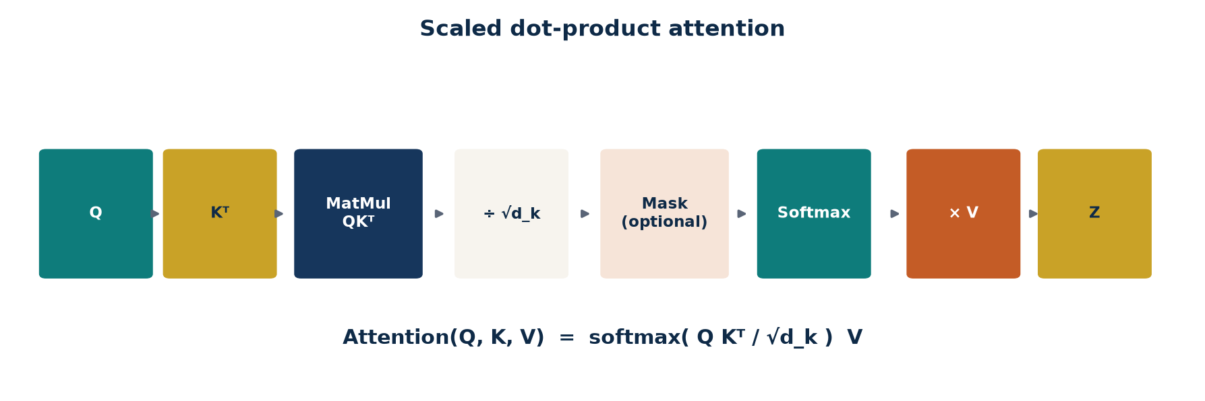
THE CENTRAL EQUATION
Scaled dot-product attention
Vaswani et al. · notes “How to compute attention”
Attention(Q, K, V) = softmax( Q Kᵀ / √d_k ) V
a_ij = q_i · k_j then ÷ √d_k then softmax over j then Σ_j α_ij v_j
Q, K, V are n × d_k matrices. One GEMM gives every pairwise score.
TLM Deep Learning · Session 6 · Transformers
20

Slide 21
WORKED EXAMPLE · 2
A 3-token sentence, d_k = 2
Tokens: The cat sat. We start from already-projected Q, K, V so the arithmetic stays on one slide.
Given
Step A · raw dots Q Kᵀ
Q = K =
The [ 1.0 , 0.0 ]
cat [ 0.0 , 1.0 ]
sat [ 1.0 , 1.0 ]
V =
The [ 1.0 , 0.0 ]
cat [ 0.0 , 2.0 ]
sat [ 1.0 , 1.0 ]
√d_k = √2 ≈ 1.414
The·The = 1·1 + 0·0 = 1
The·cat = 1·0 + 0·1 = 0
The·sat = 1·1 + 0·1 = 1
cat·The = 0 cat·cat = 1 cat·sat = 1
sat·The = 1 sat·cat = 1 sat·sat = 2
Q Kᵀ =
[[ 1 , 0 , 1 ],
[ 0 , 1 , 1 ],
[ 1 , 1 , 2 ]]
TLM Deep Learning · Session 6 · Transformers
21
Notes:
sat is aligned with both axes, so sat·sat = 2 — the strongest raw score. That will survive softmax.

Slide 22
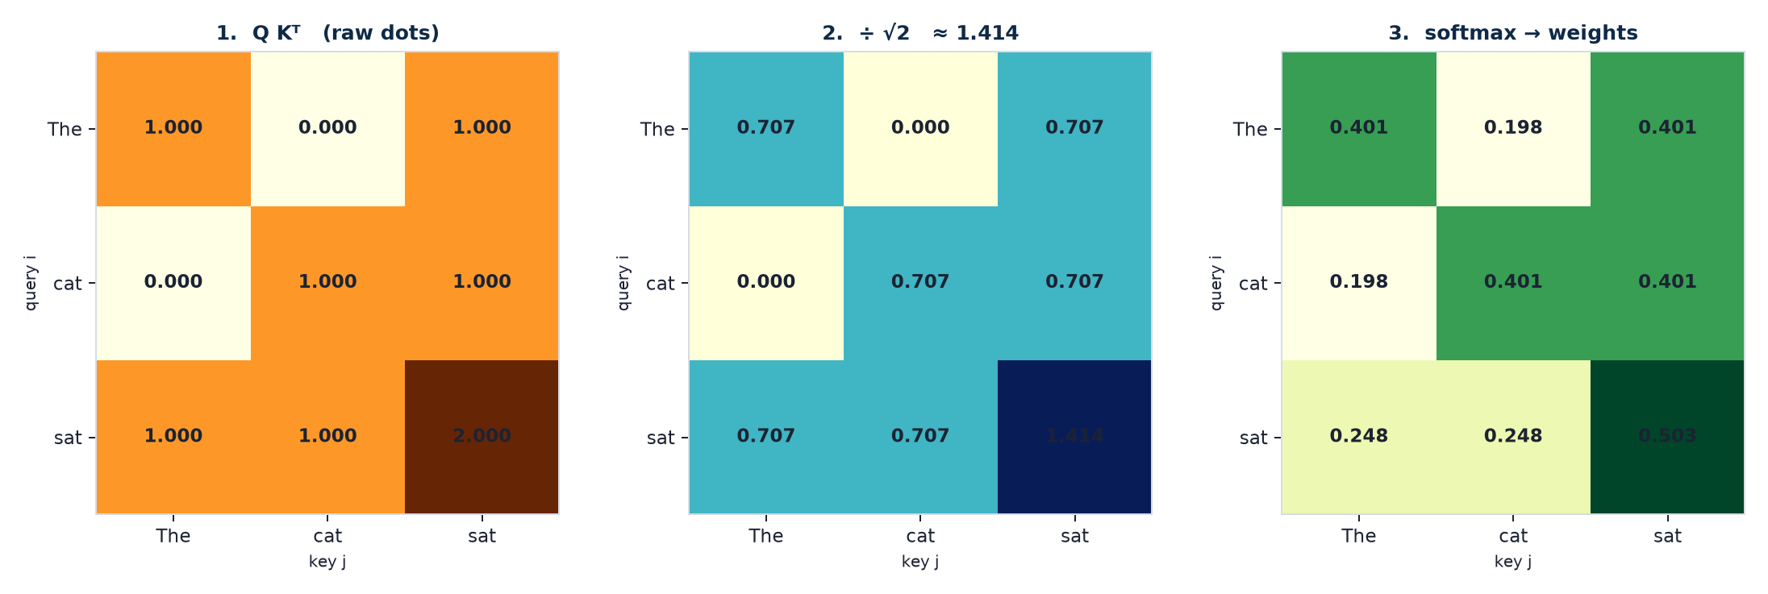
WORKED EXAMPLE · 3
Scale, softmax, weighted values
Step B–D · one query worked in full (token “sat”)
scaled = [1, 1, 2] / 1.414 = [0.707, 0.707, 1.414]
e^{0.707} = 2.028 e^{1.414} = 4.112 sum = 8.168
α_sat = [0.248, 0.248, 0.503]
z_sat = 0.248·[1,0] + 0.248·[0,2] + 0.503·[1,1] = [0.752, 1.000]
TLM Deep Learning · Session 6 · Transformers
22
Notes:
The other rows: z_The=[0.802, 0.797], z_cat=[0.599, 1.203]. Each output is a blend of all values, weighted by relevance.

Slide 23
WORKED EXAMPLE · 4
The three output vectors
The
α = [0.401, 0.198, 0.401] [ 0.802 , 0.797 ]
z = 0.401[1,0] + 0.198[0,2] + 0.401[1,1]
Looks equally at The and sat; almost ignores cat.
cat
α = [0.198, 0.401, 0.401] [ 0.599 , 1.203 ]
z = 0.198[1,0] + 0.401[0,2] + 0.401[1,1]
Mixes cat and sat. The y-component rises because V_cat = [0,2].
sat
α = [0.248, 0.248, 0.503] [ 0.752 , 1.000 ]
z = 0.248[1,0] + 0.248[0,2] + 0.503[1,1]
Self-weight 0.50 — sat keeps half of its own value.
TLM Deep Learning · Session 6 · Transformers
23

Slide 24
WORKED EXAMPLE · 5
From embeddings to Q — one matrix multiply
Same three tokens. d_model = 2. This is the step the previous slides started after.
X and W_Q
Compute each query
X =
The [ 1.0 , 0.0 ]
cat [ 0.5 , 1.0 ]
sat [ 0.0 , 1.0 ]
W_Q = [[ 0.8 , 0.2 ],
[ 0.4 , 0.6 ]]
q_i = x_i W_Q (row × matrix)
q_The = [1.0, 0.0] W_Q
= [0.80, 0.20]
q_cat = [0.5, 1.0] W_Q
= [0.80, 0.70]
q_sat = [0.0, 1.0] W_Q
= [0.40, 0.60]
K and V are the same pattern with W_K, W_V.
TLM Deep Learning · Session 6 · Transformers
24
Notes:
Do one more row on the board if time: k_The = x_The W_K. Then you are back at example 2.

Slide 25
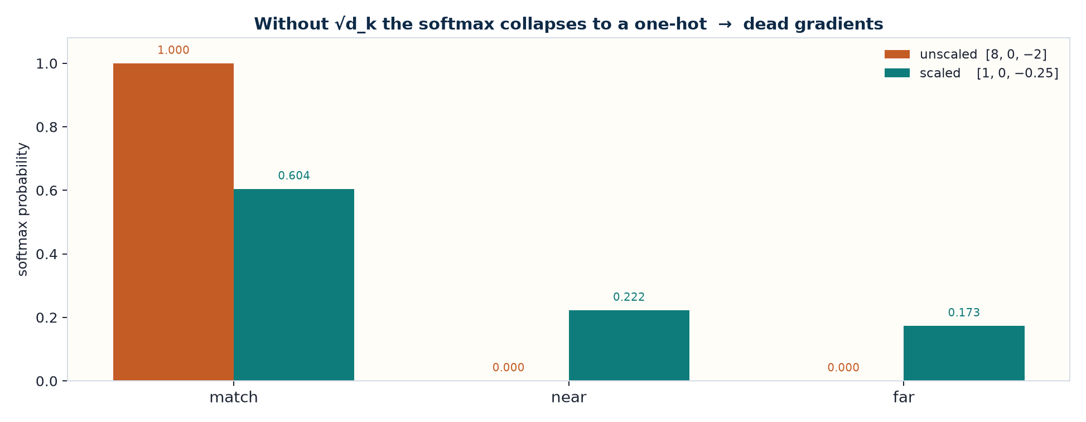
WORKED EXAMPLE · 6
Why divide by √d_k ?
If keys and queries are roughly unit-scale, Var(q·k) ≈ d_k. For d_k = 64 the raw dots sit near ±8.
By hand
unscaled [8, 0, −2]
softmax ≈
[0.9996, 0.0003, 0.00005]
almost one-hot →
gradient through softmax ≈ 0
÷ √64 = 8
scaled [1.00, 0.00, −0.25]
softmax ≈
[0.604, 0.222, 0.173]
usable, differentiable routing
TLM Deep Learning · Session 6 · Transformers
25
Notes:
This is the entire reason for the word “scaled” in scaled dot-product attention.

Slide 26
A SUBTLE POINT
Attention is not symmetric
Notes
The attention function from word i to word j is not the same as from word j to word i.
Why?
What it buys
Softmax makes it worse
a_ij uses q_i · k_j. a_ji uses q_j · k_i. W_Q ≠ W_K, so the two dots live in different spaces.
“bank” can attend strongly to “river” while “river” attends to “flowed”. Relations need not be mutual.
Each row is normalised on its own. Row i and row j do not even share a partition of mass.
TLM Deep Learning · Session 6 · Transformers
26

Slide 27
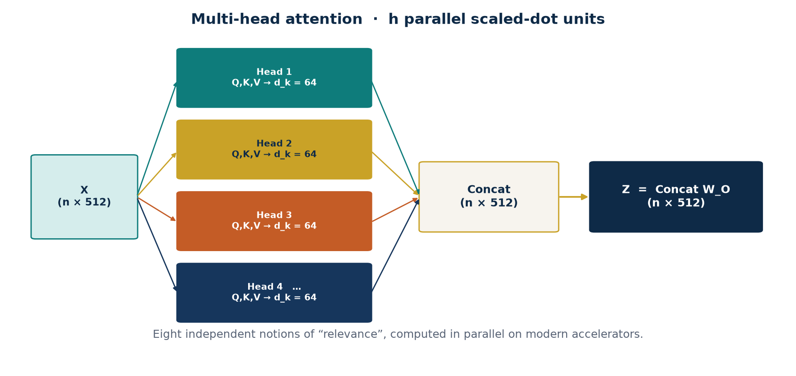
MULTI-HEAD
Many definitions of “relevant”, in parallel
Reference implementation: h = 8 heads, each with d_k = d_v = 64, so 8 × 64 = 512 = d_model. The notes: multiple heads let the model keep several incompatible notions of relevance — syntax, coreference, next-word, negation — and modern hardware evaluates them together.
TLM Deep Learning · Session 6 · Transformers
27

Slide 28
WORKED EXAMPLE · 7
Two heads, then concat and W_O
Head outputs are 2-D. Concat gives 4-D. W_O maps back to d_model = 4.
After attention (token “sat”)
Project with W_O
Head 1 (syntax-ish)
z1 = [ 0.75 , 1.00 ]
Head 2 (meaning-ish)
z2 = [ 0.20 , −0.40 ]
Concat = [ 0.75, 1.00, 0.20, −0.40 ]
Take W_O = (1/4) I_4 for a clean hand step.
out = Concat W_O
= [ 0.188, 0.250,
0.050, −0.100 ]
Then: residual + LayerNorm.
x ← LN( x + out )
That vector enters the FFN.
TLM Deep Learning · Session 6 · Transformers
28
Notes:
Heads do not share W_Q/W_K/W_V. In code they are one fat multiply split along the last axis.

Slide 29
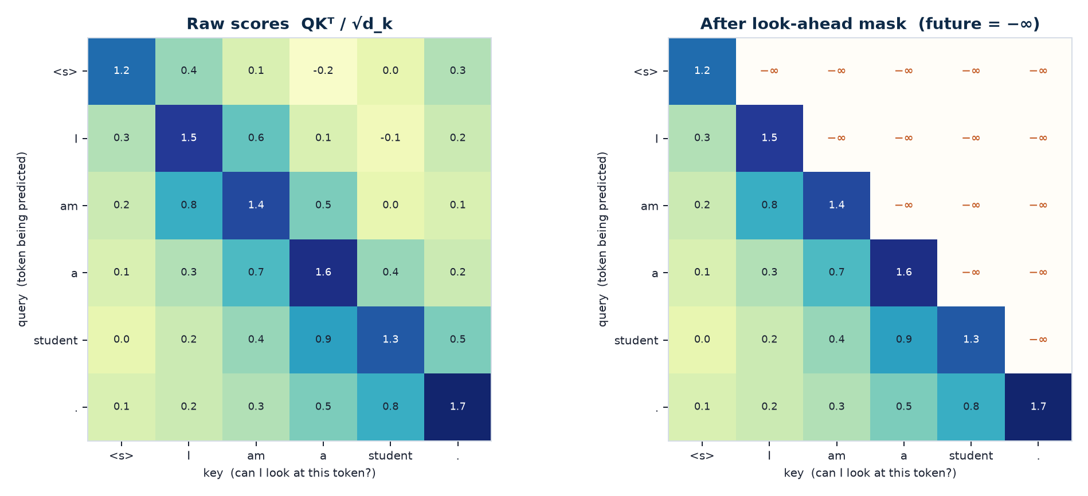
LOOK-AHEAD MASK
The decoder is not allowed to see the future
TLM Deep Learning · Session 6 · Transformers
29
Notes:
Notes implementation: to predict token 3, only tokens 1 and 2 are used. Padding masks are a second, independent mask.

Slide 30
WORKED EXAMPLE · 8
Causal mask on a 3-token prefix
Decoder is predicting the next English token. Prefix: <s> I am
Scores before the mask
After mask → softmax
<s> I am
<s> 1.2 0.4 0.1
I 0.3 1.5 0.6
am 0.2 0.8 1.4
Upper triangle is the future.
Set those entries to −∞.
<s> [1.2, −∞, −∞]
→ [1.000, 0, 0]
I [0.3, 1.5, −∞]
e^0.3=1.350 e^1.5=4.482
→ [0.231, 0.769, 0]
am [0.2, 0.8, 1.4] (no mask)
→ [0.175, 0.319, 0.506]
TLM Deep Learning · Session 6 · Transformers
30
Notes:
Row 0 can only attend to itself. That is teacher-forcing-safe causal LM.

Slide 31
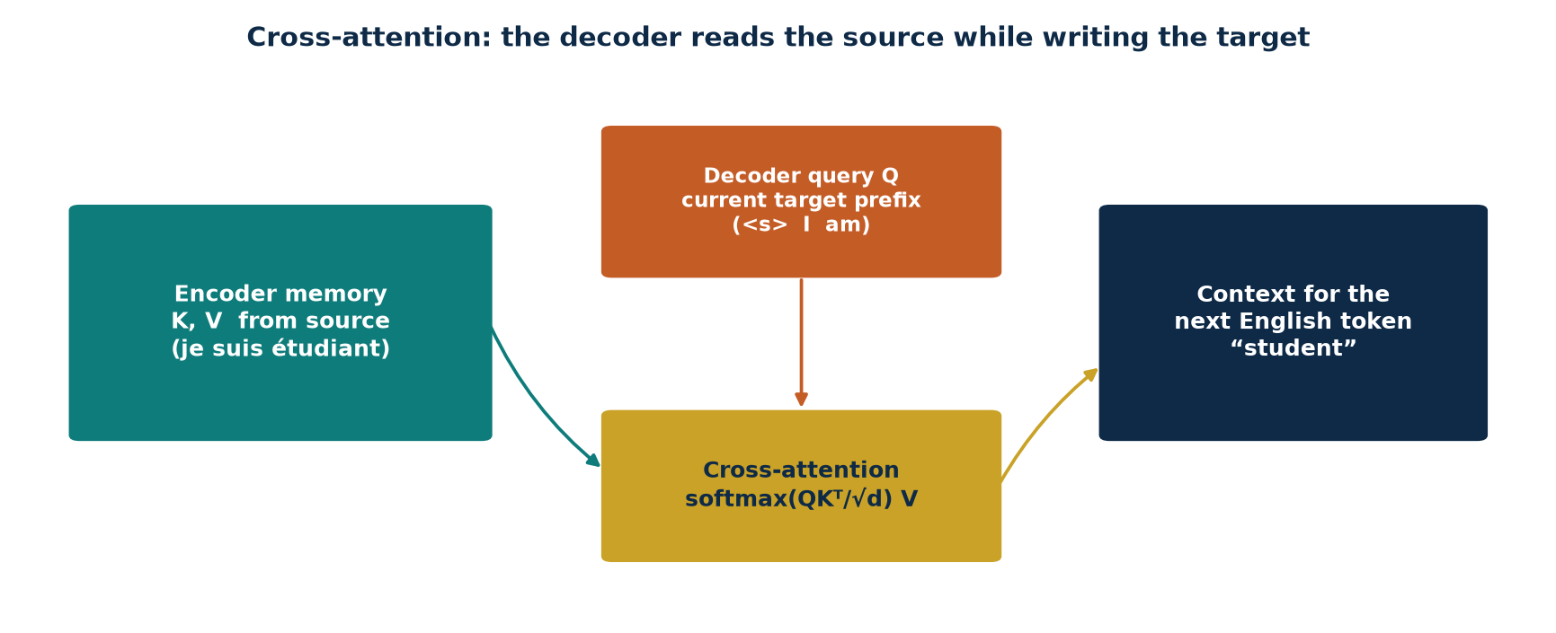
CROSS-ATTENTION
The only place the target reads the source
Q from the decoder
K, V from the encoder
No look-ahead here
The current English prefix: what am I trying to write next?
The whole Portuguese sentence, already contextualised. Sent to every decoder block.
The source is fully known. Only decoder self-attention is causal.
TLM Deep Learning · Session 6 · Transformers
31

Slide 32
POSITION-WISE FFN
The same MLP, applied to every token
Notes · two dense layers, ReLU in between
FFN(x) = max(0, x W₁ + b₁) W₂ + b₂
d_model = 512 → 2048 → 512 (same MLP at every position)
Position-wise
Why expand to 2048?
Then Add & Norm
Token 1 and token 7 share weights, but their activations never mix inside the FFN. Mixing already happened in attention.
A wide ReLU MLP is a universal per-token function. Attention routes; the FFN transforms.
The FFN output is added back to its input and normalised. That vector is the input to the next block — or, at the last encoder, the memory.
TLM Deep Learning · Session 6 · Transformers
32

Slide 33
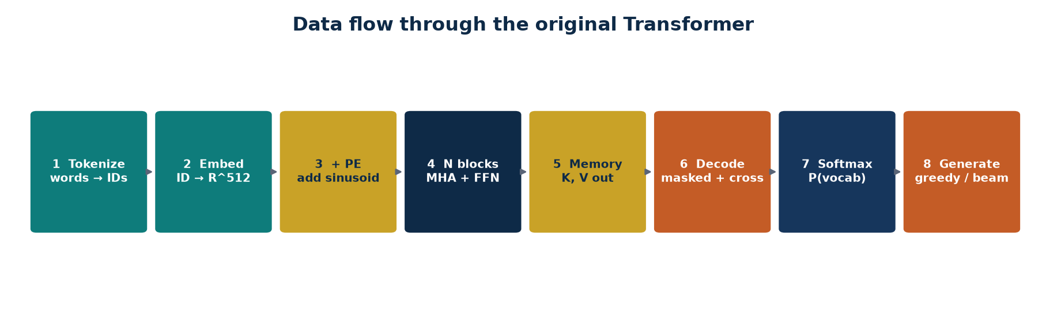
END-TO-END DATA FLOW
From raw sentence to next-token distribution
Encoder path
Decoder path
Readout
Tokenize source → embed → +PE → 6 × (MHA, Add&Norm, FFN, Add&Norm) → memory K, V.
Tokenize target (shifted) → embed → +PE → 6 × (masked MHA, cross-MHA, FFN) → 512-d embeddings.
Dense to |vocab|. Softmax. Train with teacher forcing; infer by feeding the model’s own token back.
TLM Deep Learning · Session 6 · Transformers
33

Slide 34
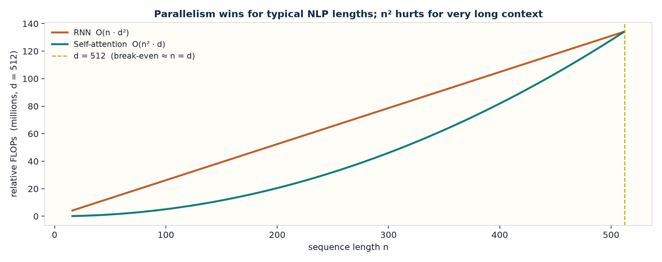
DEEP INSIGHT
Parallelism is the point — n² is the price
Takeaways
• RNN: O(n · d²), sequential in n.
• Attention: O(n² · d), parallel in n.
• Break-even near n ≈ d (512).
• Sentences win; books lose.
• That is why the notes list LSH, local, Reformer, BigBird.
• Depth (N=6) is cheap once the sequence is parallel.
TLM Deep Learning · Session 6 · Transformers
34

Slide 35
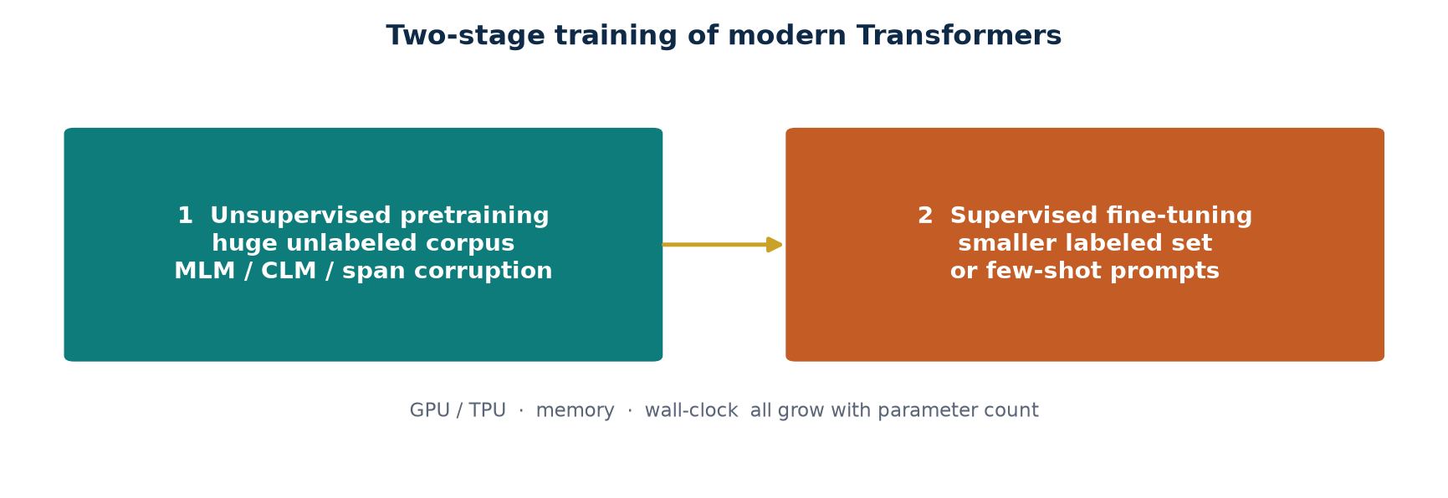
TRAINING
Semi-supervised, in two steps
Unsupervised pretraining
Supervised fine-tuning
Why it works
Masked LM (BERT), causal LM (GPT), span corruption (T5). Needs a very large corpus and serious GPU / TPU time.
A smaller labelled set: translation, QA, classification. Sometimes so small it is few-shot — the notes already name this.
Pretraining builds a general residual stream. Fine-tuning only has to retarget the readout — or, in few-shot, not even that.
TLM Deep Learning · Session 6 · Transformers
35

Slide 36
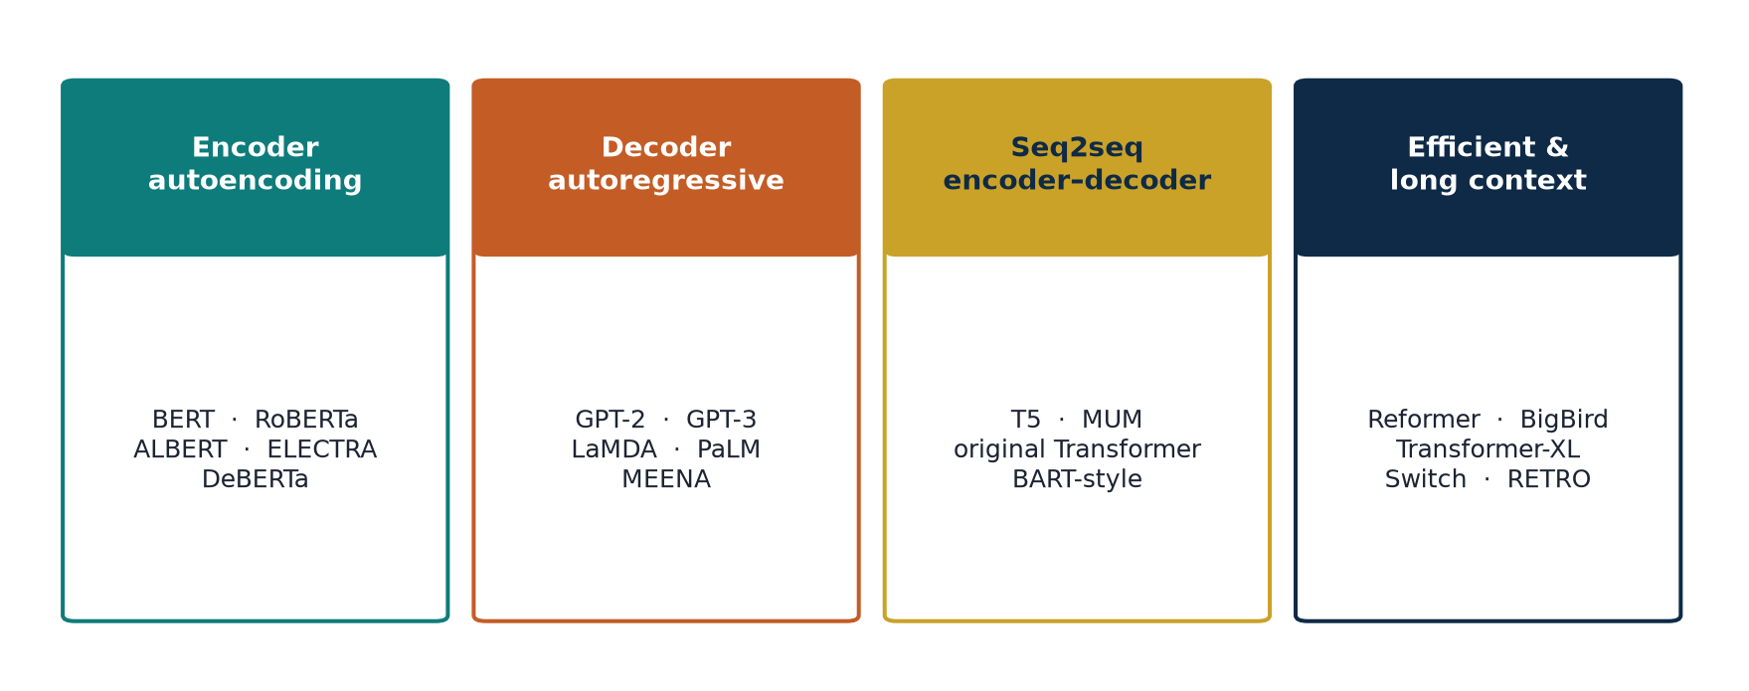
ARCHITECTURE FAMILIES
The notes’ map of the post-2017 zoo
TLM Deep Learning · Session 6 · Transformers
36
Notes:
Also listed: full vs sparse attention, LSH, local, encoder pretraining vs encoder–decoder pretraining, Switch, RETRO, Pathways/PaLM, LaMDA.

Slide 37
LANDMARK MODELS
What the notes expect you to be able to place
BERT / RoBERTa / ALBERT
Encoder only. Bidirectional MLM. Workhorse for classification, NER, QA.
GPT-2 / GPT-3 / PaLM
Decoder only. Causal LM. In-context learning appears as the model grows.
T5 / MUM
Encoder–decoder. Every task is text-to-text.
Transformer-XL / XLNet
Longer context (segment recurrence) and permutation LM.
Reformer / BigBird
Hashing or sparse patterns so n² becomes closer to n.
ELECTRA / DeBERTa / StructBERT
Better pretraining objectives and disentangled attention.
TLM Deep Learning · Session 6 · Transformers
37

Slide 38
IMPLEMENTATION · NOTES
Portuguese → English, the TensorFlow walk-through
1
Libraries
tensorflow, tensorflow_text, TensorFlow Datasets. The Colab in the notes is missing import tensorflow_text — add it.
2
Data
Load the PT–EN pair corpus. Drop examples longer than MAX_TOKENS.
3
Tokenize
Text → token IDs, used as indices into an embedding table. Inspect IDs and pieces.
4
Batch
Map, padded batch. Two functions: filter-by-length, then tokenize-batch.
5
PE + masks
Sinusoidal PE in d-dimensional space. Padding mask + look-ahead mask.
6
Blocks
Scaled dot-product → multi-head (linear, attention, linear) → point-wise FFN → encoder / decoder / Transformer.
TLM Deep Learning · Session 6 · Transformers
38

Slide 39
IMPLEMENTATION · SHAPES
What each tensor is doing
Input IDs
(batch, T_src)
Integer Portuguese tokens, padded.
Target IDs
(batch, T_tgt)
English tokens, shifted right for teacher forcing.
Embeddings + PE
(batch, T, 512)
Same width on both sides.
Attention scores
(batch, h, T_q, T_k)
One heatmap per head.
Head output Z
(batch, T, 512)
Concat of 8 × 64, times W_O.
Logits
(batch, T_tgt, V)
V = English vocab. Sparse categorical cross-entropy vs. the unshifted target.
TLM Deep Learning · Session 6 · Transformers
39

Slide 40
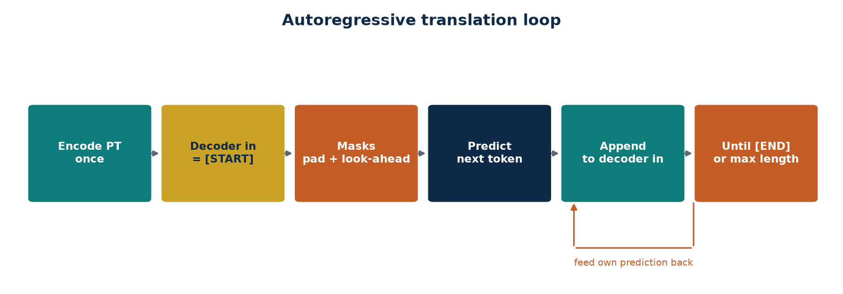
INFERENCE
The transformer is autoregressive at decode time
• Encode the Portuguese sentence once with tokenizer.pt — the memory is reused every step.
• Decoder input starts as [START]. Padding and look-ahead masks are rebuilt as the prefix grows.
• The decoder looks at encoder output (cross-attention) and at its own prefix (masked self-attention).
• Concatenate the predicted token and call the decoder again, until [END] or a length cap.
• Notes: greedy argmax, or a more sophisticated search such as beam search.
TLM Deep Learning · Session 6 · Transformers
40
Notes:
Teacher forcing at train time: feed the gold previous token. At test time: feed the model’s own prediction.

Slide 41
IMPLEMENTATION · TRAINING LOOP
Hyperparameters, loss, checkpoints
Optimizer & loss
train_step
Checkpoints
Adam with the paper’s warmup learning-rate schedule (or a close variant). Sparse categorical cross-entropy on the unshifted English IDs. Padding tokens are masked out of the loss.
The model is autoregressive. A look-ahead mask stops it from peeking at the expected output. Current decoder output is used only to predict the next token.
Save encoder, decoder, and the final linear layer. Restore for inference without rebuilding the dataset pipeline.
Reference sizes from the seminal paper (notes)
N = 6 blocks h = 8 heads d_model = 512 d_k = d_v = 64 d_ff = 2048
PE: sinusoid, no learned params decode: greedy or beam search
TLM Deep Learning · Session 6 · Transformers
41

Slide 42
SUMMARY
What should stick after this session
Attention replaces recurrence
Q, K, V + √d_k
Four ideas
Every token may read every other token in one GEMM. Path length is O(1).
q_i·k_j is similarity; V is the payload; scaling keeps softmax alive.
Positional encoding, attention, self-attention, multi-head — the whole recipe.
Encoder vs decoder
Residual highway
Train, then decode
Encoder is bidirectional. Decoder is causal + cross-attends to encoder memory.
LN(x + Sublayer(x)) is how depth works. Layers write deltas into a stream.
Pretrain / fine-tune. Infer autoregressively with a look-ahead mask.
TLM Deep Learning · Session 6 · Transformers
42

Slide 43
CHEAT SHEET
The eight hand calculations, in one place
1 PE
d=4, pos=0,1,2
[0,1,0,1] [0.841, 0.540, 0.010, 1] [0.909, −0.416, 0.020, 1]
2 Dots
QKᵀ for The/cat/sat
[[1,0,1],[0,1,1],[1,1,2]]
3 Scale + softmax
÷ √2, then softmax
sat → α = [0.248, 0.248, 0.503]
4 Weighted V
z = α V
z_sat = [0.752, 1.000]
5 x W_Q
one query from X
q_The = [1,0] W_Q = [0.80, 0.20]
6 √d_k
d_k = 64
softmax([8,0,−2]) ≈ one-hot; ÷8 restores a usable distribution
7 Two heads
concat · W_O
[0.75,1,0.20,−0.40] · (¼ I) = [0.188, 0.250, 0.050, −0.100]
8 Causal mask
prefix <s> I am
row 0 → [1,0,0] row 1 → [0.231, 0.769, 0]
TLM Deep Learning · Session 6 · Transformers
43

Slide 44
FURTHER READING
The paper, and the notes around it
Vaswani et al., Attention Is All You Need, NeurIPS 2017.
Bahdanau, Cho, Bengio — Neural Machine Translation by Jointly Learning to Align and Translate, 2014.
The Illustrated Transformer — Jay Alammar. A visual companion to every block on these slides.
Chapter 6 of Deep Learning TLM session 6.docx · Portuguese–English TensorFlow notebook.
TLM Deep Learning · Session 6 · Transformers
Based on Deep Learning TLM session 6.docx
Notes:
Close with: when is an encoder enough (BERT), when a decoder (GPT), when the full stack (T5 / translation)?

